Slide 1
Sanitary Engineering
Sewerage Engineering
Secondary Treatment System
By
Dr. Muhanad M. Abbas

Slide 2
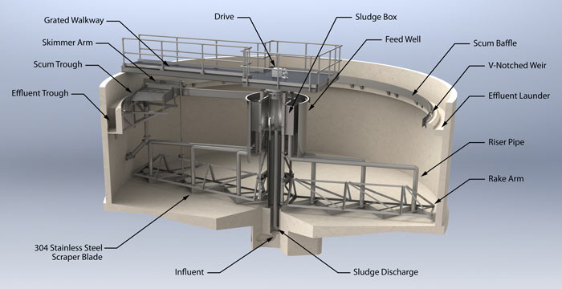
Suspended Growth Process clarifier design

Slide 4
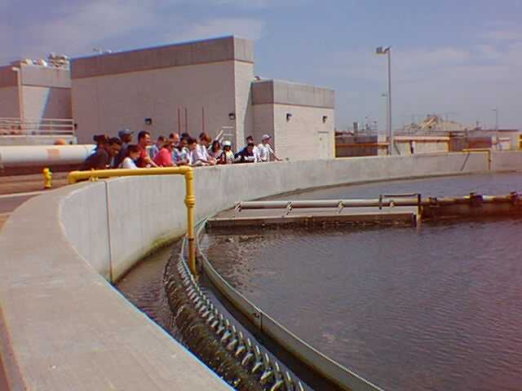

Slide 5
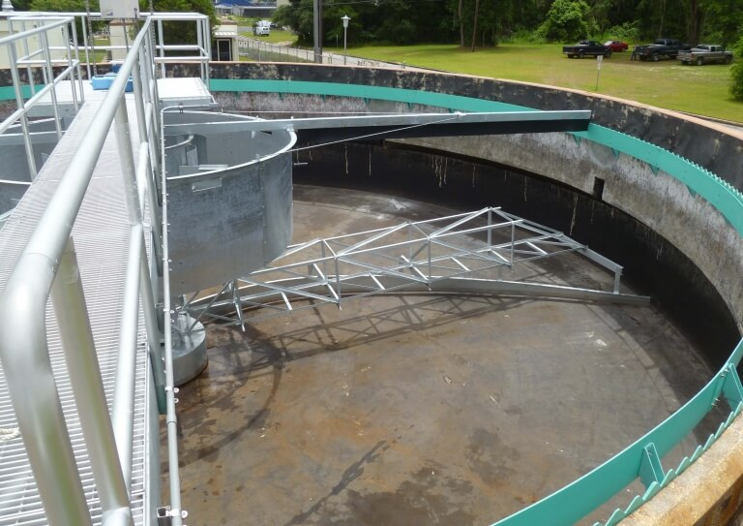

Slide 6
